Slide 1

OPEN
Light load — everything gets through
KungFlow
Protect your focus
LEARNING
Load rising — KungFlow is watching your behavioral rhythm.
KungFlow senses cognitive overload in real time and quietly blocks
interruptions — automatically. Healthier minds, deeper work.
PROTECTED
Overload — interruptions quietly blocked
Ido Mark · Rotem Saraf · Eden Elkayam · 2026
Notes:
Source audit:
- Current opening slide from KungFlow Pitch.pptx.
- Current team: Ido Mark, Rotem Saraf, Eden Elkayam.

Slide 2


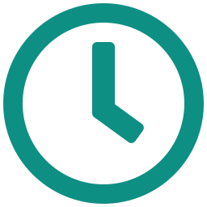

THE PROBLEM & TARGET AUDIENCE
Digital interruptions repeatedly break focus
56
23 min
26%
interruptions per workday
to regain deep focus
higher stress / lower job satisfaction
Pings, messages and alerts — one every ~9 minutes
After every single interruption (Mark, UC Irvine)
Digital interruptions increase stress, frustration and time pressure.
TARGET AUDIENCE:
Employees
Computer-based workers facing frequent digital interruptions, losing focus and experiencing higher stress.
Companies
Organizations employing these workers lose productive time and work efficiency when focus is repeatedly disrupted.
2
Notes:
Source audit:
- Interruption frequency and focus-recovery facts from KungFlow Pitch.pptx / KungFlow Investor Pitch.pptx.
- Human-impact stress statements from current deck and older investor deck.
- Two-sided audience framing supplied in the user's final deck instructions.

Slide 3
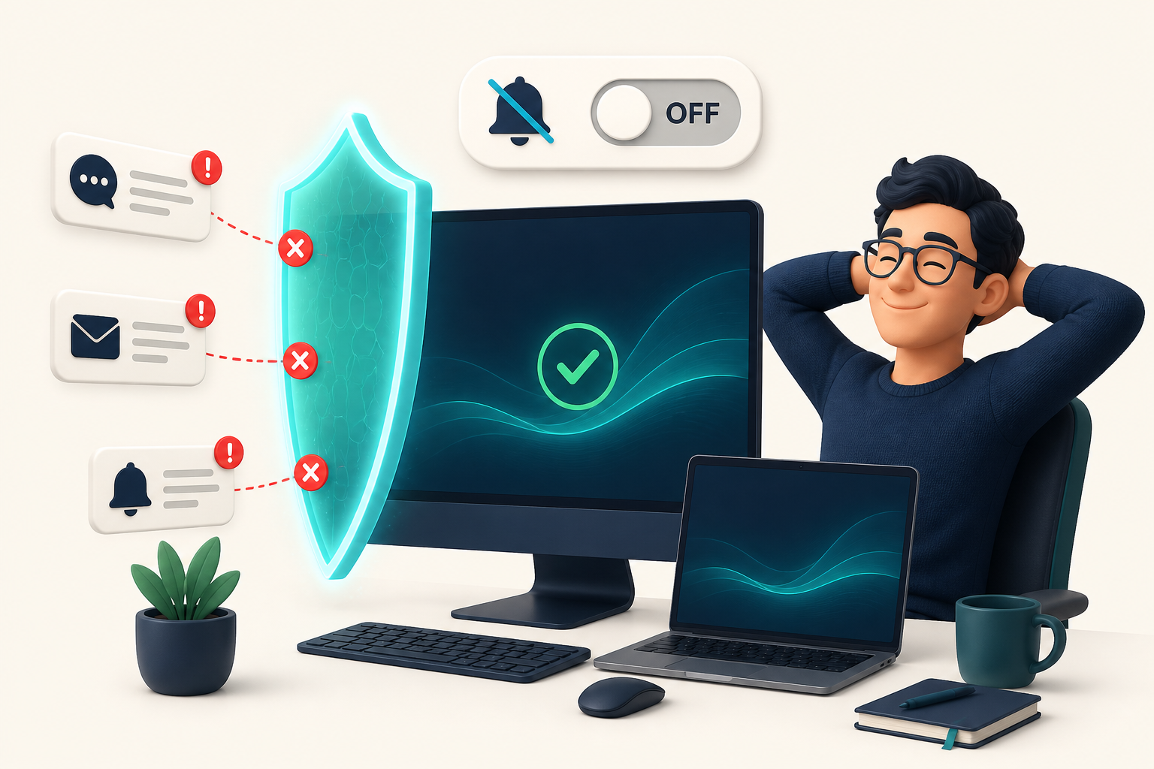




THE SOLUTION
KungFlow — a firewall for your focus
1 · SENSE
2 · UNDERSTAND
3 · PROTECT
Reads behavioral rhythm only — typing speed, window switches, mouse motion. Every minute, silently.
Scores cognitive load against your personal baseline. It learns what “normal” means for you.
Load exceeds baseline? The firewall activates in the user's chosen mode: global or selective. Load drops? Protection turns off.
No buttons. No willpower. No new habits. The employee just works — KungFlow guards the door.
3
Notes:
Source audit:
- Sense / Understand / Protect flow from KungFlow Pitch.pptx.
- Global/selective firewall mode from current implemented desktop product.

Slide 4
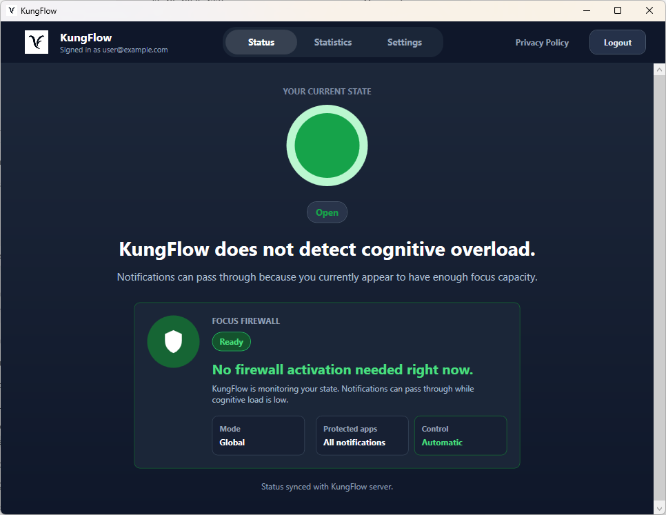
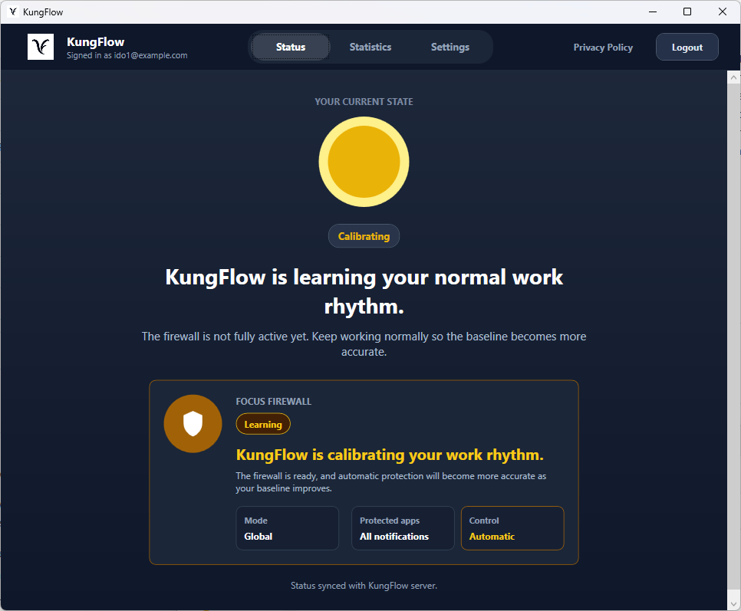
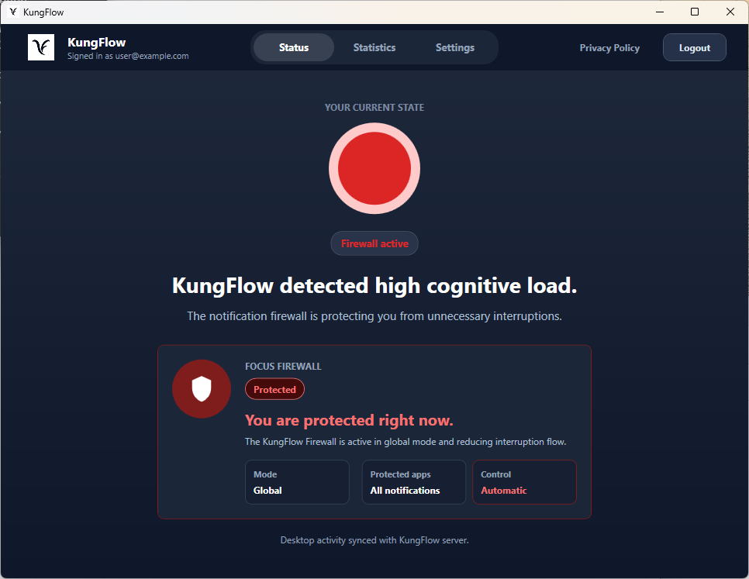
THE PRODUCT
The product — live demo transition
Open state
Calibrating
Firewall active
Low cognitive load: notifications can pass through.
KungFlow is learning the user baseline before full automation.
High load detected: the notification firewall protects focus.
These states are what the team will demonstrate live: open, calibrating, and firewall activation.
4
Notes:
Source audit:
- Current product-state concept and screenshots from KungFlow Pitch.pptx.
- This slide intentionally transitions into the live demo instead of creating a separate demo slide.

Slide 5
VALIDATION
Research-backed foundation + our controlled validation
Task accuracy — score out of 20
+165%
49%
better task scores
fewer errors missed
once interruptions were removed
in the same 10-minute window
RESEARCH-BACKED FOUNDATION
OUR CONTROLLED PILOT
• Digital interruptions and context switching are associated with cognitive overload, stress, and reduced focus.
• Mouse, typing, and switching behavior can provide indicators related to cognitive load.
• Reducing interruptions can improve focus and task performance.
Controlled pilot, n=8, with a learning-effect control group. Larger study planned with design partners.
Full research references are available in the project README on GitHub.
5
Notes:
Source audit:
- Validation figures copied from KungFlow Investor Pitch.pptx validation slide.
- Research framing summarized from the Git project README Research And Validation section.
- Framed as research support plus initial controlled validation of the interruption/focus hypothesis, not a validation of the detection algorithm or company-wide productivity.

Slide 6


TRUST BY DESIGN
Behavioral metadata, not surveillance
KUNGFLOW NEVER SEES
56% vs 40%
of digitally monitored employees feel tense or stressed at work, compared to non-monitored peers (APA, Work in America 2023).
What you type
Websites you visit
Documents you open
Screenshots — of anything, ever
IT ONLY SENSES RHYTHM
Typing behavior, mouse movement, and app/window switching metadata
The data belongs to the employee and works for the employee. KungFlow is a perk, not a watchdog.
All signals are anonymized and aggregated — managers see team trends only, never an individual's score.
Every employee can pause data collection. One toggle, no questions.
6
Notes:
Source audit:
- Privacy boundaries and metadata categories from KungFlow Pitch.pptx and current implemented project.

Slide 7
MARKET · ALTERNATIVES · DIFFERENTIATION
The missing layer is automatic, real-time protection
TAM
SAM
SOM Y1
1.2B
400K
2,500
knowledge workers worldwide
tech workers in Israel — our beachhead
users across 10 mid-market companies
Acts automatically, in real time?
RescueTime
Calm for Business
MS Viva Insights
Built-in DND
KungFlow
reports after the fact
outside the workflow
org dashboards only
needs the user to act
detects & protects on its own
7
Notes:
Source audit:
- TAM/SAM/SOM, competitors and differentiation from KungFlow Pitch.pptx / KungFlow Investor Pitch.pptx.

Slide 8
NEXT STEPS
Business and technology next steps
BUSINESS · 1
BUSINESS · 2
BUSINESS · 3
TECH / PRODUCT
Design partners
Founder-led sales
Scale outbound
Scale & validate
Start with design partners from the team network to validate usage and collect feedback.
Direct outreach to VP R&D and VP People at Israeli tech companies.
Scale outbound and publish a measured case study with design partners.
Scale & v2 development. Larger study / validation with design partners.
Next step: prove the product in real teams, improve the prototype, and validate the focus-protection workflow.
8
Notes:
Source audit:
- Business next steps from current GO-TO-MARKET and GTM slides.
- Technology/product next steps limited to scale & v2 development and larger validation with design partners from the investor source.

Slide 9

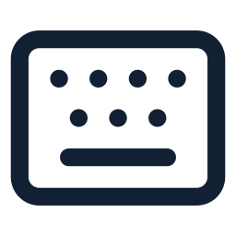

HOW WE DO IT
Research-backed signals and personalized scoring
Behavioral signals were selected based on prior research linking computer-interaction patterns with cognitive load.
References: project README on GitHub
Mouse movement
Typing behavior
App switching
Speed, acceleration, and micro-pauses help detect rising stress during real work.
Typing rhythm, pace changes, and delete/backspace use reveal friction without storing content.
Window switching and visible/open-window patterns show context switching and attention fragmentation.
Weighted behavior signals compared with the user's personal/adaptive baseline
9
Notes:
Source audit:
- Signal categories and scoring concept from KungFlow Pitch.pptx.
- Research framing summarized from the Git project README Research And Validation section.
- Does not claim the literature validates the complete product or scoring algorithm.

Slide 10

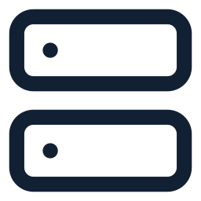

ARCHITECTURE
System architecture & cloud deployment
A lightweight client-server loop connects the Windows agent, the Cloud Run server, and SQL storage.
Desktop Agent
PROTECTION DECISION RETURNS
KungFlow Server
SQL Database
Collects behavioral rhythm on Windows: typing rhythm, mouse movement, window/app switching, and open-window patterns. Applies the returned protection decision.
Node.js / Express server, deployed with Docker on Google Cloud Run. Receives samples, scores current load against the personal baseline, and returns a protection decision.
Google Cloud SQL stores users, sessions, behavioral metrics/samples, personal baseline, current state, and firewall state/events.
ACTIVITY SAMPLE
METRICS + BASELINE
C#
.NET
Windows
Node.js
Express
Docker
SQL
Cloud SQL
Baseline
The agent sends metadata samples, the server stores metrics and baseline state, and the firewall decision returns to the desktop in real time.
Core technologies and tools we used
C#
.NET
Windows
Node.js
Express
SQL
Docker
Cloud
Git
10
Notes:
Source audit:
- Agent, server, SQL database, metrics/baseline and protection-decision loop from KungFlow Pitch.pptx.
- Docker, Google Cloud Run and Google Cloud SQL from KungFlow_Project_Poster.pptx.
Technology logo sources:
- Simple Icons: .NET, Node.js, Express, Docker, Google Cloud, Git.
- Devicon: C#, Windows, Microsoft SQL Server.

Slide 11
ENGINEERING
Technical challenges & engineering decisions
1 · Detect without content
2 · Personal baseline
3 · Protection loop
Use behavioral metadata: typing rhythm, mouse movement, and app/window switching. Do not collect typed text, websites, documents, or screenshots.
Compare each user against a personal/adaptive baseline instead of applying one universal behavior level.
Desktop Agent sends samples. The server scores them with stored metrics and baseline. A protection decision returns to the agent.
Implemented loop
Desktop Agent → activity sample → server scoring against baseline ↔ SQL metrics + baseline → protection decision → Desktop Agent
11
Notes:
Source audit:
- Privacy-by-metadata decision from Trust and How We Do It slides.
- Personal/adaptive baseline from How We Do It and Solution slides.
- Client-server-database loop from Architecture slide and project poster.

Slide 12

Thank you.
For questions and more details
Ido Mark · idoomark23@gmail.com
Notes:
Closing slide added per request. Contact: Ido Mark, idoomark23@gmail.com.

